Slide 1

Southeast Asia Regional Standards for Mathematics Teachers (SEARS-MT)

Slide 2
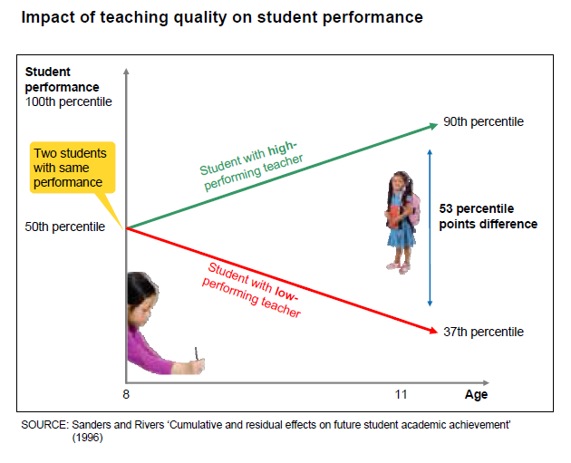

Slide 3
Overview
Background
Teachers’ role and Teacher Quality
Rationale of developing Southeast Asia Regional Standards – Mathematics Teachers (SEARS-MT)
Goal & Purpose of SEARS-MT
Methodology
The users of SEARS-MT
Framework of SEARS-MT
What’s next?

Slide 4
Background
“All countries are seeking to improve their schools, and to respond better to higher social and economic expectations. As the most significant and costly resource in schools, teachers are central to school improvement efforts.”
(OECD, 2005, p.1)

Slide 5
Teachers’ role: Multi-tasking & Multilevel
Individual student level
Classroom
School
Parents and wider community

Slide 6
Teacher Quality
Teacher quality is the key schooling factor influencing student outcomes (Aaronson, Barrow, & Sander, 2007; Rivkin, Hanushek, & Kain, 2005; Rockoff, 2004; Goldhaber, Brewer, & Anderson, 1999).
Notes:
At the individual student level - Initiating and managing learning processes - Responding effectively to the learning needs of individual learners - Integrating formative and summative assessment At the classroom level - Teaching in multi-cultural classrooms - New cross-curricular emphases - Integrating students with special needs At the school level - Working and planning in teams - Evaluation and systematic improvement planning - ICT use in teaching and administration - Management and shared leadership At the level of parents and the wider community - Providing professional advice to parents - Building community partnerships for learning

Slide 7
Teacher Quality: Conceptualisation
Author (year) | Conceptulisation
Darling-Hammond (2000) | Teaching preparation and confidence
Goe (2007); Schmidt & Hunter (1983) | Experience and knowledge
Waxman et. al. (2003) | Pedagogical skills, positive attitude, as well as organized and managed classroom skills
Harris & Rutledge (2007) | Cognitive ability, personality attributes, and educational background
Rockoff et al. (2008) | Cognitive ability, content knowledge, personality traits, and feelings of self-efficacy

Slide 8
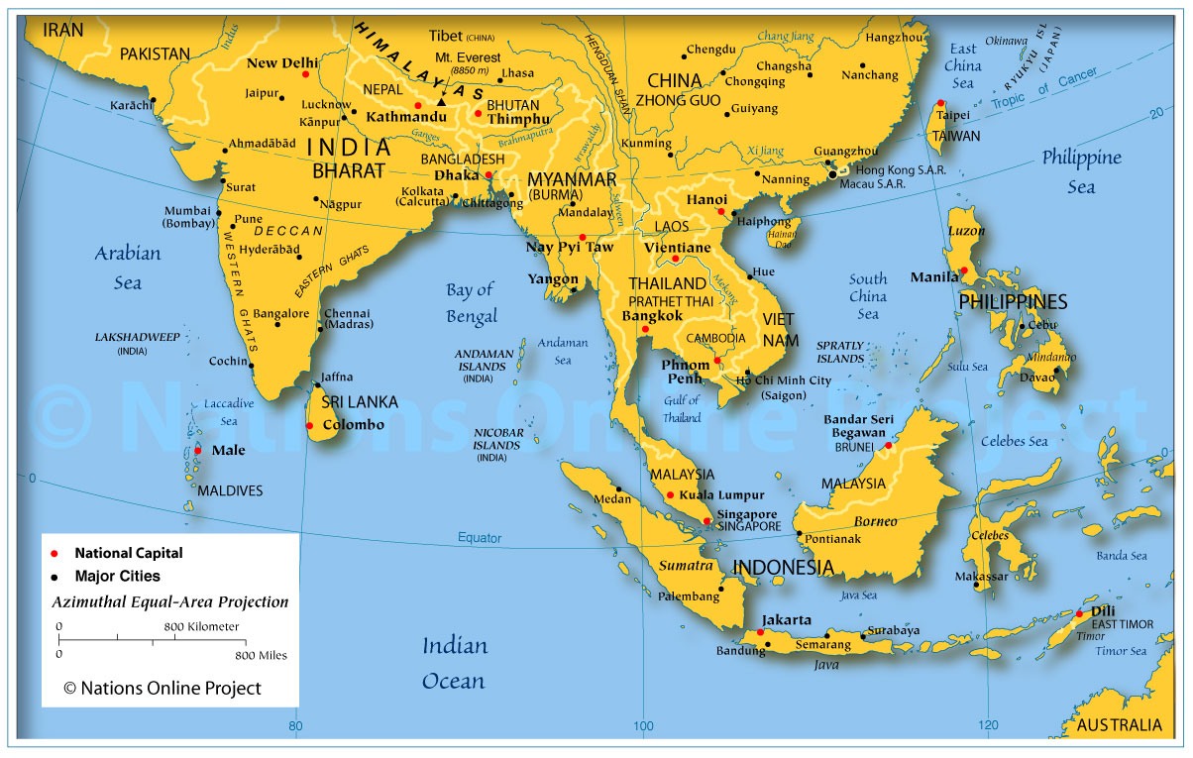
Brunei Darussalam
Cambodia
Indonesia
Lao PDR
Myanmar
Malaysia
Philippines
Singapore
Thailand
Timor Leste
Vietnam

Slide 9
Country | Teacher Standards
Indonesia | Teacher Academic and Qualification Standard: Pedagogical, personal, social, and professional competency
Malaysia | Malaysia Teacher Standards (MTS): Professional values, knowledge and skills of teaching and learning
Philippines | National Competency-Based Teacher Standards: Social regard for learning, learning environment, diversity of learners, curriculum, planning and assessing, community
Singapore | Enhanced Performance Management Scheme: Self-evaluation, coaching & mentoring, performance-linked recognition, leadership development, career development

Slide 10
The Southeast Asian Ministers of Education Organization (SEAMEO)
SEAMEO’s role uniquely represents the collective aspiration of the region to focus on quality education and human capital growth.
SEAMEO RECSAM is a Regional Centre for Education in Science and Mathematics and mandated to provide the needs of SEAMEO member countries in the development and enhancement of expertise in science and mathematics education.

Slide 11
SEARS-MT was conceptualised as part of SEAMEO RECSAM’s plans to improve the quality of mathematics teachers in the region.

Slide 12
Rationale
Despite the diversity of cultural and economic growth, there is a need to establish regional standards for mathematics teachers:
    that serve as a benchmark for monitoring improvement in teacher quality, and
    that, thus far, do not exist for the SEAMEO region.

Slide 13
Goal
To document a set of standards that describe the qualities that a 21st century mathematics teacher in the SEAMEO region should attain.

Slide 14
Purpose
As a guide to provide benchmarks or aspirational goals for relevant educational agencies in formulating policies to improve the quality of teacher development programmes that prepare and equip pre-service and in-service mathematics teachers;
As a guide in structuring teacher education programmes in both pre-service and in-service teacher preparation; and
As a guide for teacher development at the personal level. Teachers can use this document as a roadmap to guide their own personal professional development as mathematics teachers.

Slide 15
Methodology
Collaborative inquiry approach
Two consultative workshops

Slide 16
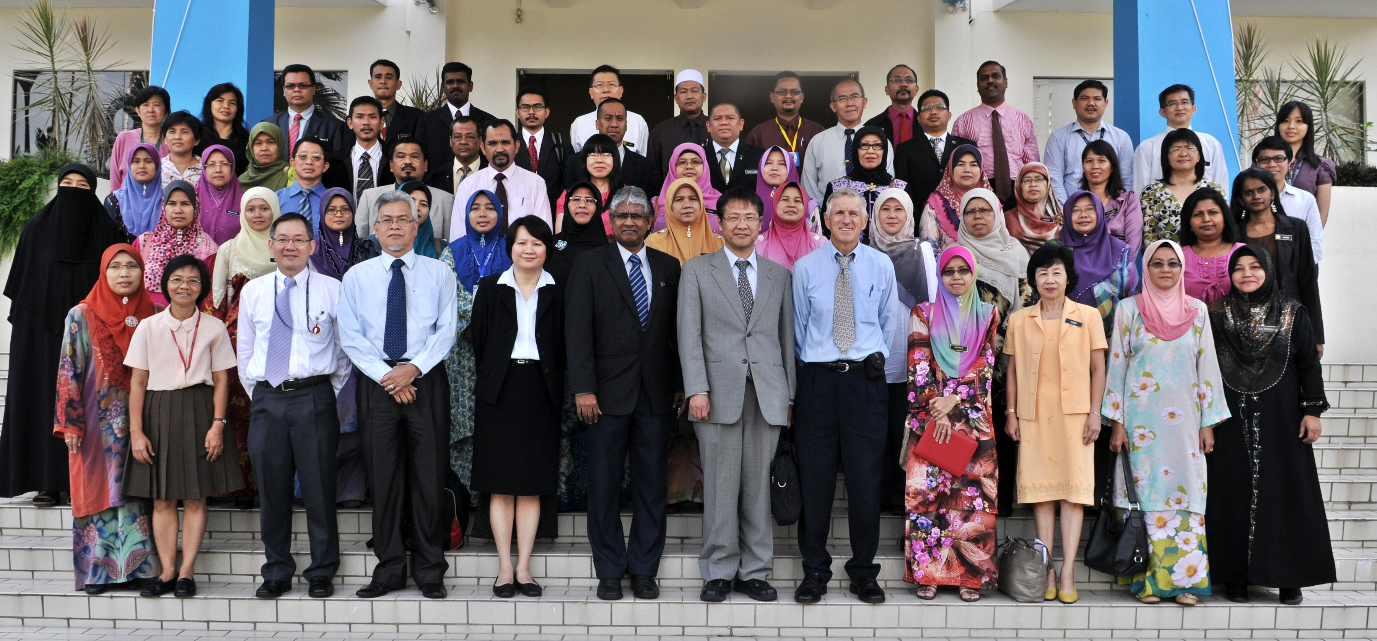
1st workshop (12 – 14 May 2013) SEAMEO RECSAM, Penang

Slide 17
1st workshop (12 – 14 May 2013) SEAMEO RECSAM, Penang
Personnel Involved
Dr. Supattra Pativisan, Thailand
Assoc. Prof. Allan L. White, Australia
Prof. Mohan Chinnappan –Australia
Prof. Takuya Baba, Japan
Prof. Madya Dr. Noor Shah bin Saad, Malaysia
Mr. Muhammad bin Ibrahim, Malaysia
Mr. Tan Khan Aun, Malaysia
Dr. Ida Karnasih, Indonesia
RECSAM academic staffs
3 presentations:
(a) Benchmarking Quality: Are Teachers a Precious Asset or a Big Problem?
(b) Professional Competence and Professional Community in Mathematics Education
(c) Understanding and Teaching Mathematics in Southeast Asian Classrooms: Challenges and Opportunities for Practice and Professional Development
Forum:
Raising Teacher Quality through the Southeast Asian Mathematics Teachers Standards

Slide 18
1st workshop (12 – 14 May 2013) SEAMEO RECSAM, Penang
References:
(1) The Standards for Excellence in Teaching Mathematics in Australian Schools (Australian Association of Mathematics Teachers, 2006),
(2) Professional Teaching Standards (NSW Institute of Teachers, 2005),
(3) The Malaysian Teachers Standards (Ministry of Education, n.d.)
(4) The Teaching Competency Standards in Southeast Asian Countries (SEAMEO INNOTECH, 2010).

Slide 19
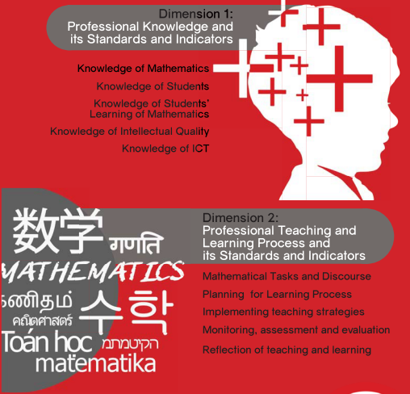
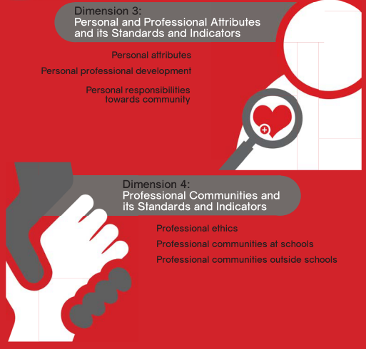
Southeast Asia Regional Standards-Mathematics Teachers

Slide 20
1st workshop (12 – 14 May 2013) SEAMEO RECSAM, Penang
Outcomes: 1st Draft of SEARS-MT
Dimensions: (1) Professional knowledge,
(2) Professional teaching and learning process,
(3) Personal and professional attributes, &
(4) Professional communities
Standards
Indicators

Slide 21
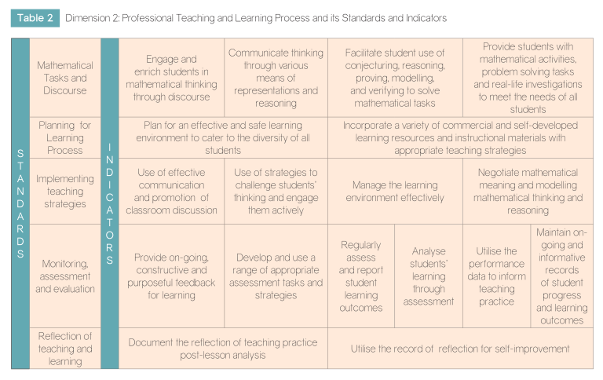

Slide 22
Personnel Involved
Country Experts: Brunei Darussalam, Cambodia, Indonesia, Laos, Malaysia, the Philippines, Thailand, Timor-Leste and Vietnam.
Participants from SEAMEO QITEP and Brunei Darussalam, and RECSAM staffs.
Country reports were presented to address the following questions:
1) How are judgments made about the quality of mathematics teachers and mathematics teaching in the country?
2) What are the guidelines that are used to make these judgments about mathematics teaching and mathematics teachers’ quality?
3) What aspects of quality mathematics teaching require further exploration and support?

Slide 23
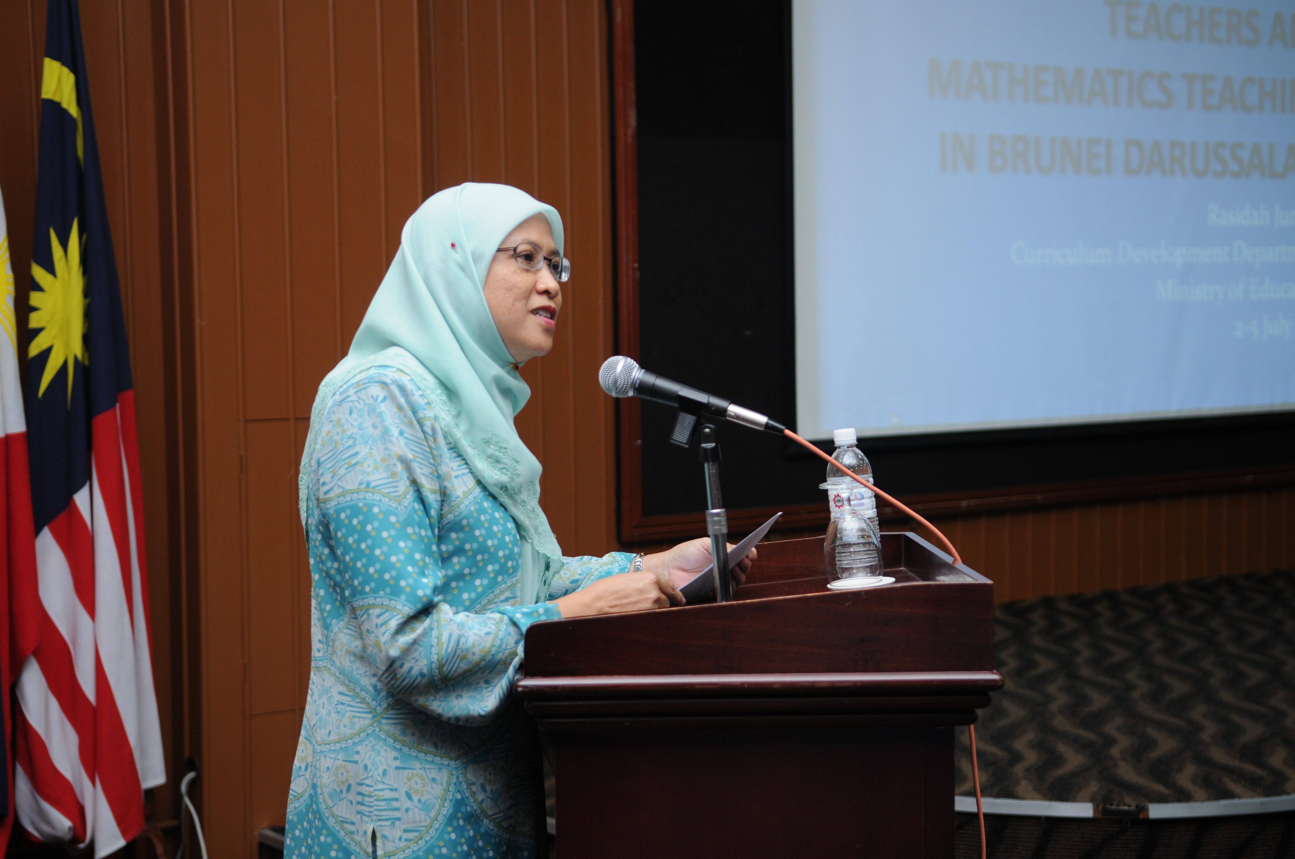
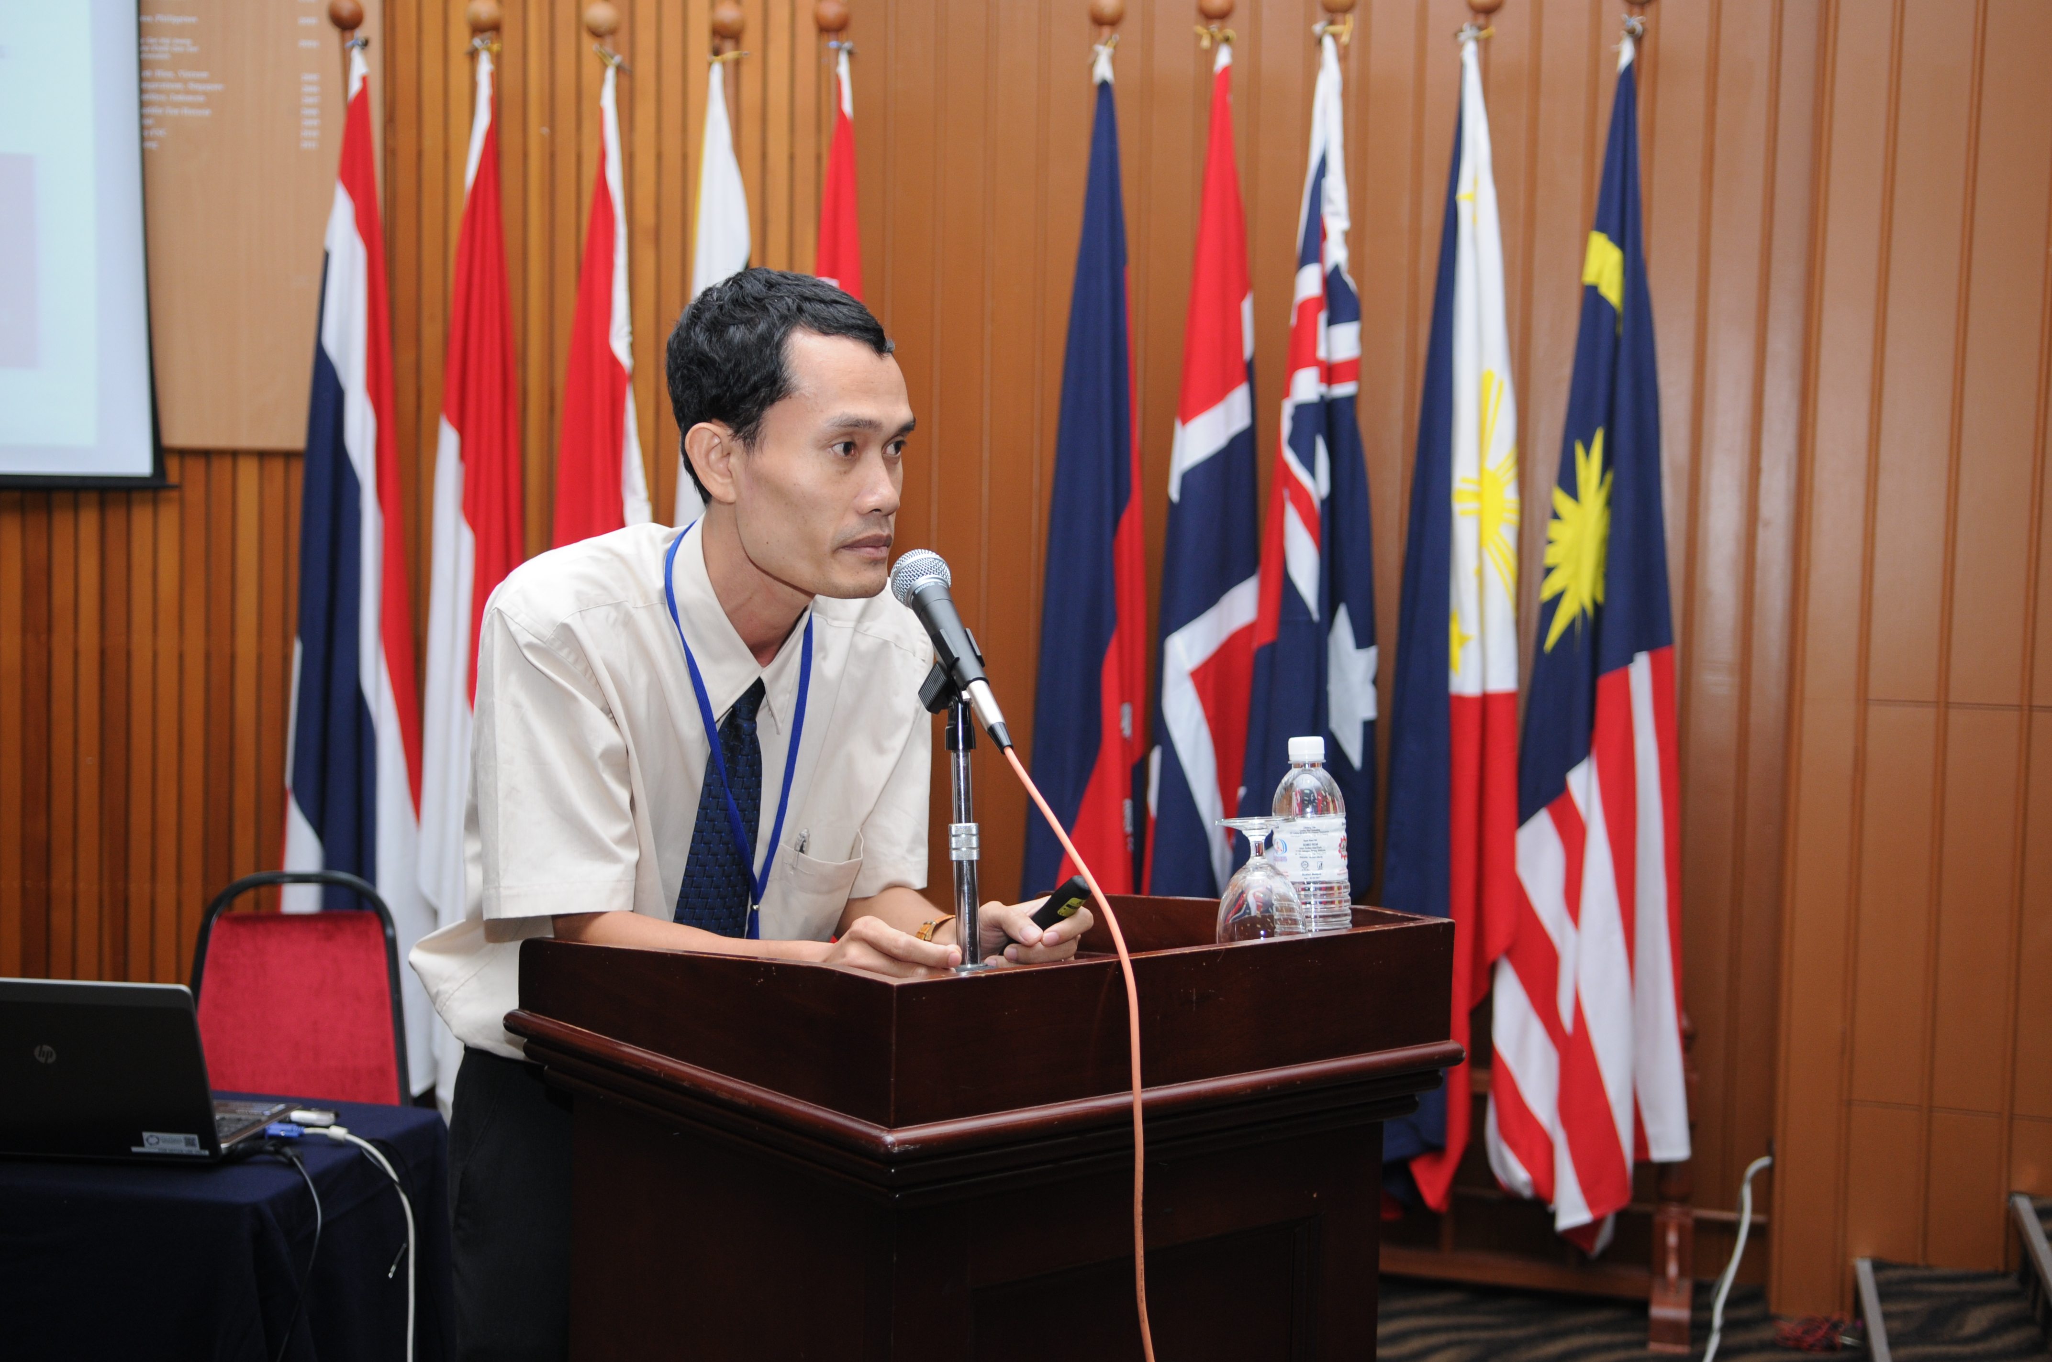
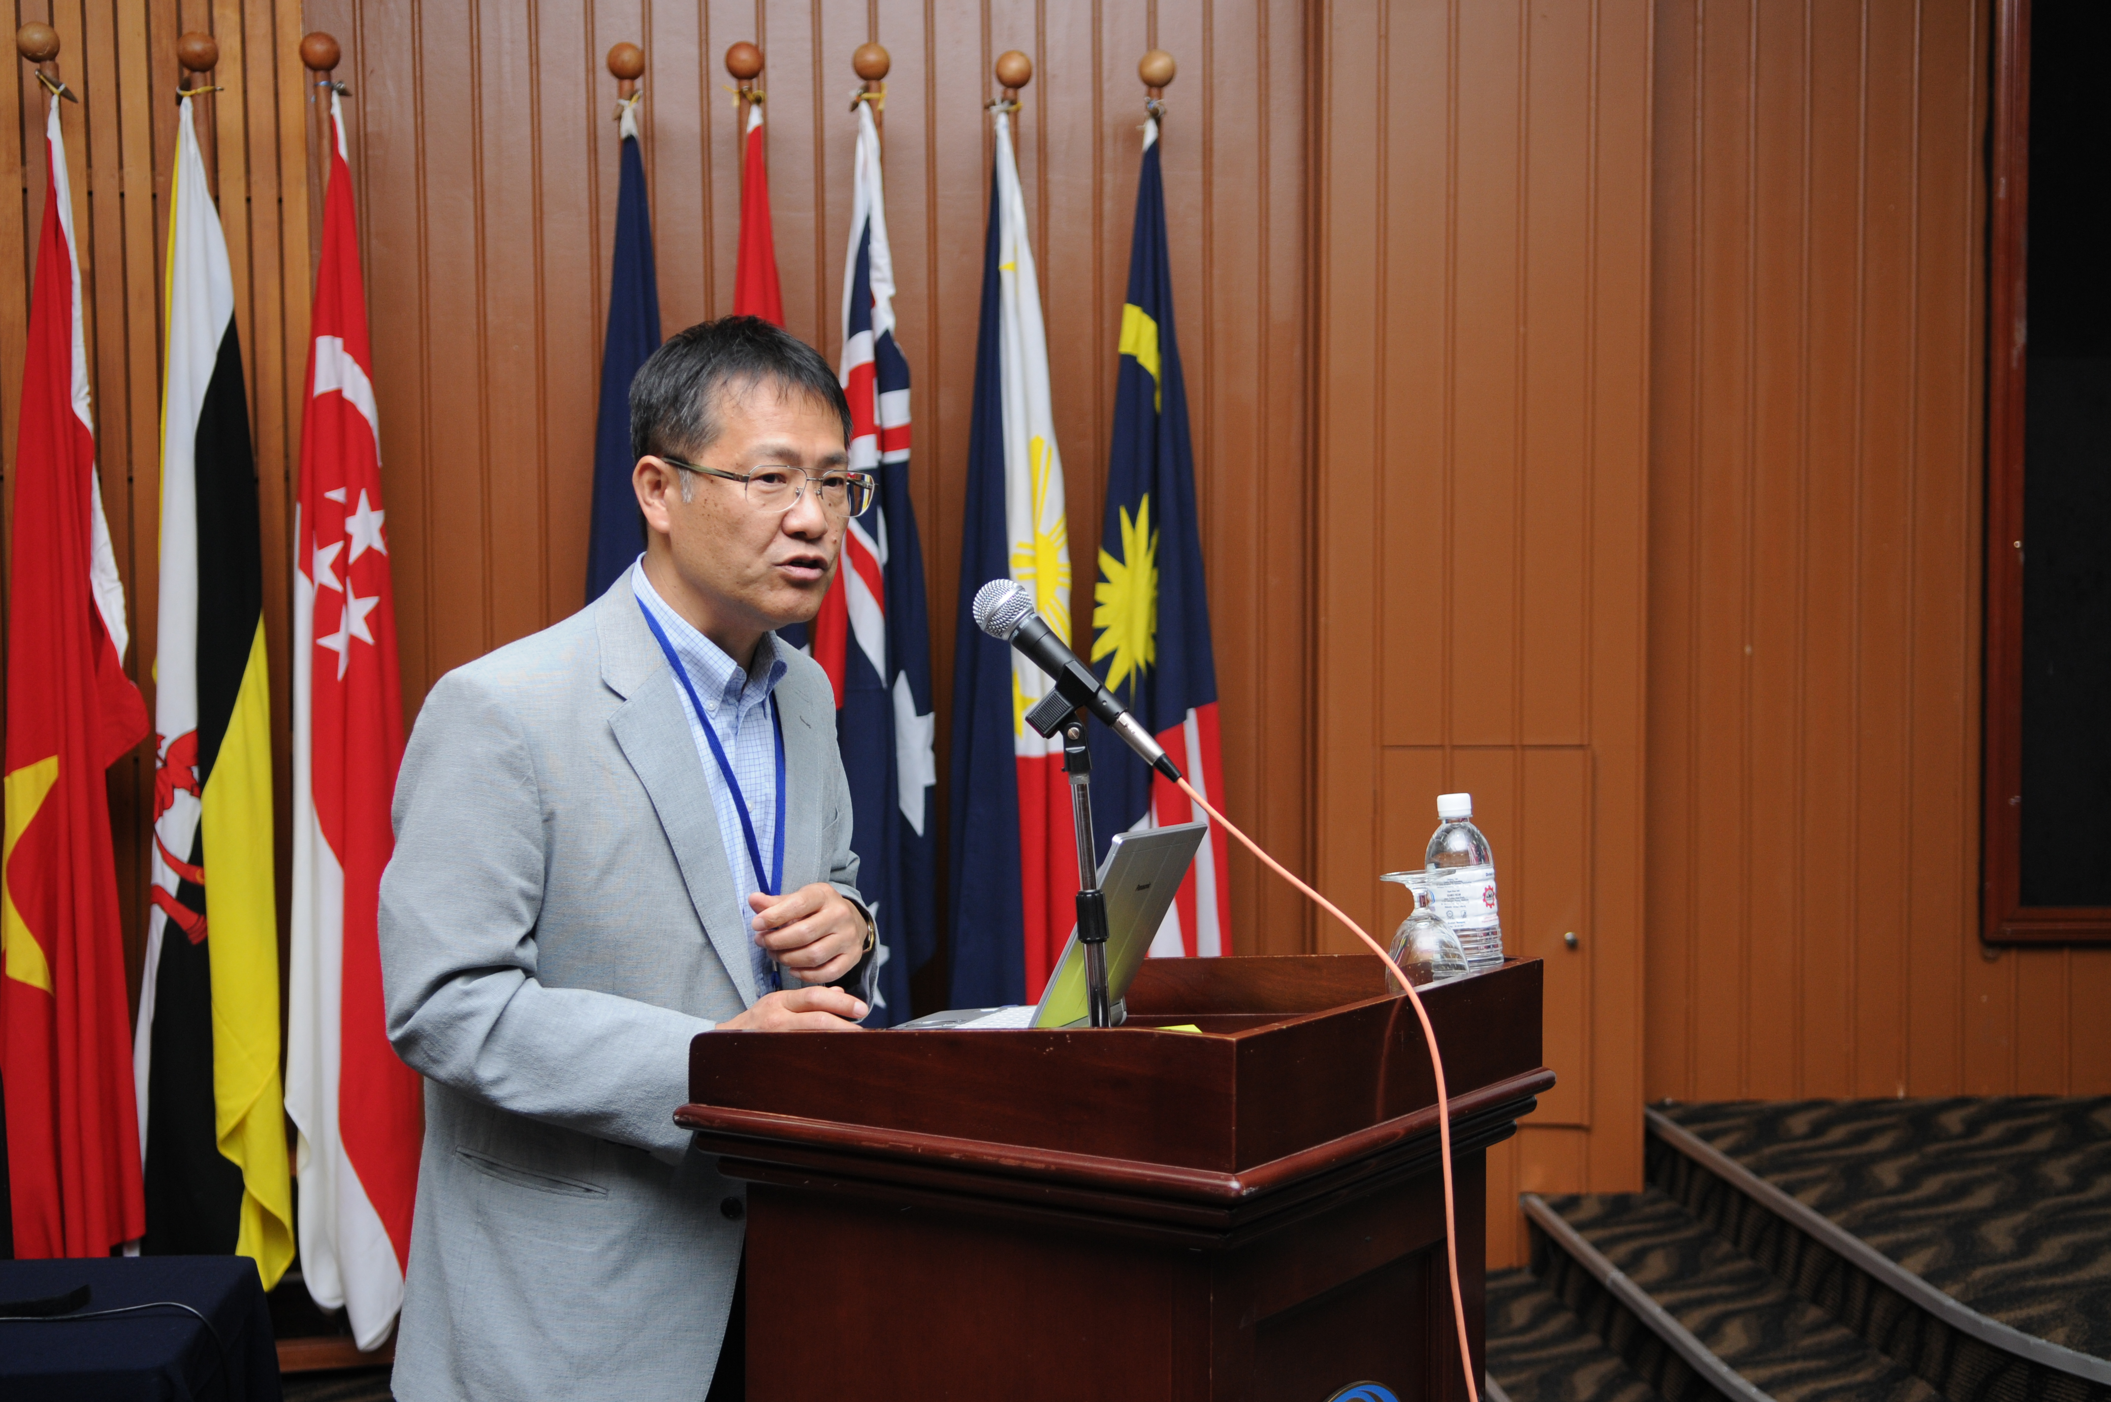
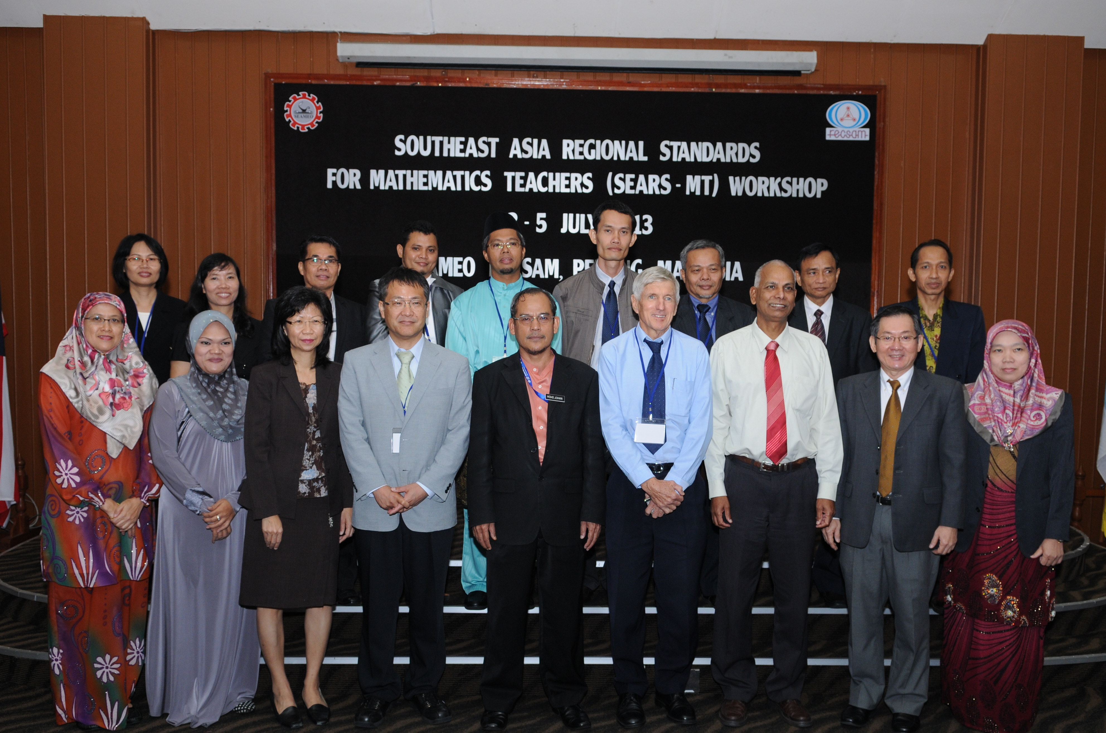
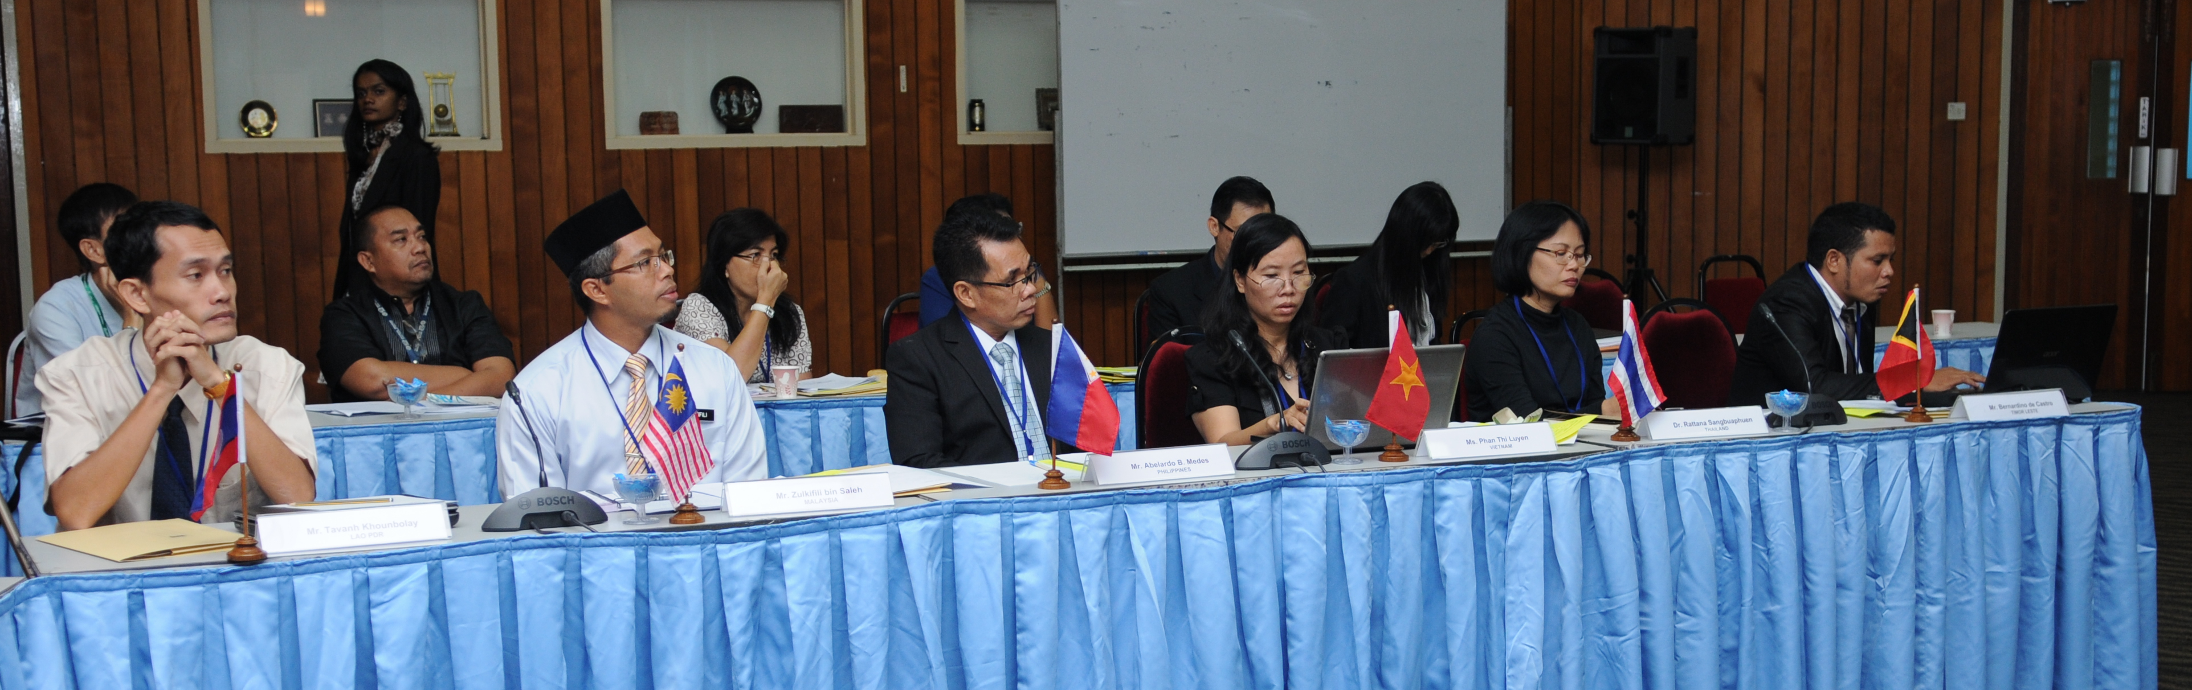
2nd Workshop (2– 5 July 2013) SEAMEO RECSAM, Penang

Slide 24
Outcomes:
(1) Reviewed and discussed the 1st draft of SEARS-MT.
(2) Each Country Expert provided in-depth feedback based on the context of their respective countries.

Slide 25
SEARS-MT: An Overview (1)
Dimension 1 | Standards | No. of indicators
Professional Knowledge | Knowledge of mathematics | 4
 | Knowledge of students | 3
 | Knowledge of students’ learning of mathematics | 5
 | Knowledge of intellectual quality | 5
 | Knowledge of ICT | 5

Slide 26
SEARS-MT: An Overview (2)
Dimension 2 | Standards | No. of indicators
Professional Teaching & Learning Processes | Mathematical tasks & discourses | 4
 | Planning for learning processes | 2
 | Implementing teaching strategies | 4
 | Monitoring assessment & evaluation | 6
 | Reflection on teaching and learning | 2

Slide 27
SEARS-MT: An Overview (3)
Dimension 3 | Standards | No. of indicators
Personal & Professional Attributes | Personal attributes | 4
 | Personal professional development | 4
 | Personal responsibilities towards community | 4

Slide 28
SEARS-MT: An Overview (4)
Dimension 4 | Standards | No. of indicators
Professional Communities | Professional ethics | 3
 | Professional communities at school | 2
 | Professional communities outside schools | 2

Slide 29
Implications
Promote the development of local descriptors aligned with contextual and cultural needs, such as Malaysian Mathematics Teacher Quality Standards (MMTQS) based on SEARS-MT.
Standardised mathematics teacher education standards that can be commonly used through the Southeast Asia region.
Provide an ideal platform to continue the academic conversation and publication of Southeast Asia Region Mathematics Teacher Standards.

Slide 30
Mathematics Teachers Standards on the Era of ASEAN Community: Proposal for the Future Teachers Education
Chief Editor: Prof. Isoda Masami
PART 1 (2—30 pages)
1.0 Trends and Issues of Teacher Education
PART 3 (40 pages)
3.0 Mathematics Teachers Perspectives from SEAMEO Countries
3.1 Brunei Darussalam
3.2 Cambodia
3.3 Indonesia
3.4 Lao PDR
3.5 Malaysia
3.6 Myanmar
3.7 Philippines
3.8 Singapore
3.9 Thailand
3.10 Vietnam
3.11 Timor Leste
PART 4 (30 pages)
4.0 Challenges
Editors ???
PART 2 (50 pages)
2.0 How do we come out a Framework?
2.1 Professional Knowledge
2.2 Professional Teaching and Learning Process
2.3 Personal Attributes
2.4 Professional Communities

